Slide 1


Handan YARICI
Senıor Software Engıneer
linkedin.com/in/handanyarici
github.com/handanyarici

Slide 2
SOFTWARE DEVELOPMENT STEPS
Problem Definition
Understanding the problem and requirements
Analysis
Working on technical requirements for the software
Coding
Developing assigned parts of software with preferred language
Testing
Testing software with the business scenarios
Documentation
Notes:
9 round programından bahset problem definition ve analiz aşamasını detaylandır.

Slide 3
SOFTWARE DesIgn Approaches
Data Flow Chart Approach
Thinking the algorithm with diagrams
Data Structure Approach
Deciding the correct data structure for the data which will be used in project.
Object Oriented Approach
Model this real world problem with the objects and communication messages between objects.
Notes:
Küçük problemler Hesap makinesi

Slide 4
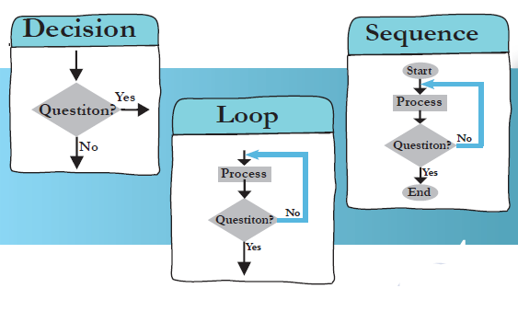
DESIGNING ALGORITHM
A process or set of rules to be followed in calculations or other problem-solving operations
What is a flowchart?
• A flowchart is a picture (graphical representation) of the problem solving process.
• A flowchart gives a step-by-step procedure for solution of a problem
Drawing a flowchart,
• Identify input and output.
• Apply reasoning skills to solve the problem.
• Draw the flowchart using the appropriate symbols and arrows to show the Guidelines sequence of steps in solving the problem.

Slide 5
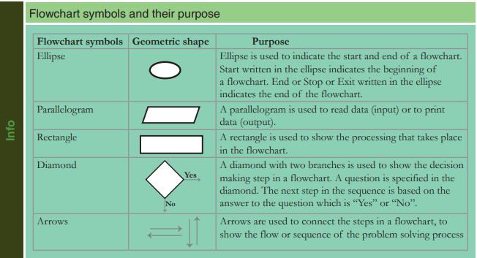
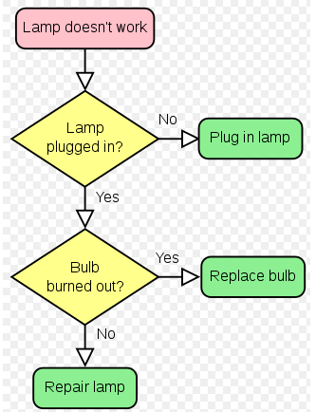
FLOWCHART

Slide 6
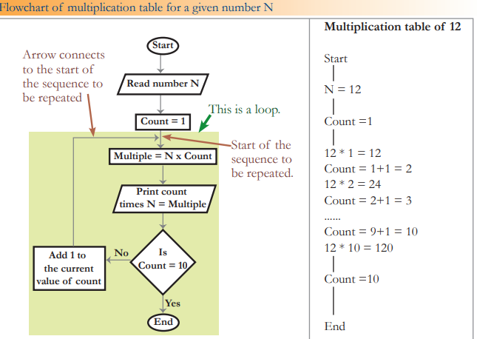
FLOWCHART

Slide 7
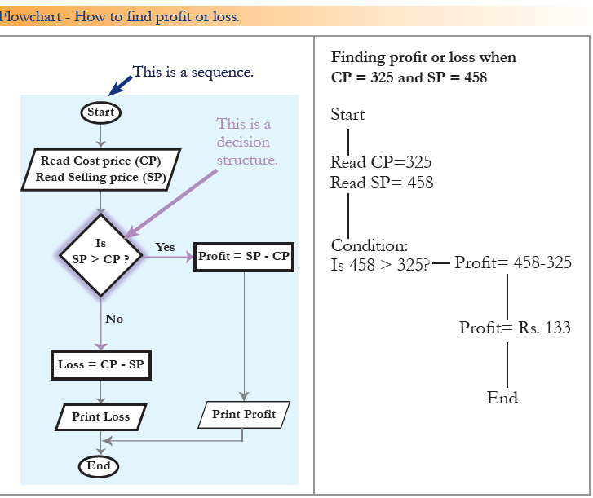
FLOWCHART

Slide 8
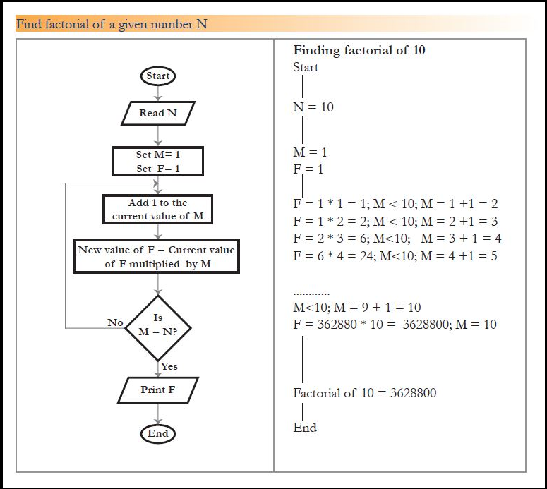
FLOWCHART

Slide 9
Data structure approach
Structured design is a conceptualization of problem into several well-organized elements of solution. It is basically concerned with the solution design. Benefit of structured design is, it gives better understanding of how the problem is being solved. Structured design also makes it simpler for designer to concentrate on the problem more accurately.
A good structured design always follows some rules for communication among multiple modules, namely -
Cohesion - grouping of all functionally related elements.
Coupling - communication between different modules.
A good structured design has high cohesion and low coupling arrangements.

Slide 10
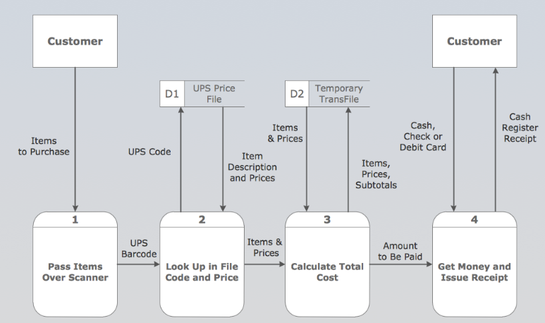
Structured desıgn

Slide 11
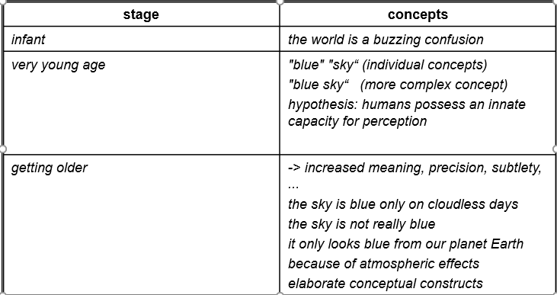
WHY OBJECT ORIENTED
“The "software crises" came about when people realized the major problems in software development were … caused by communication difficulties and the management of complexity”
Concept formation: from chaos to order!

Slide 12

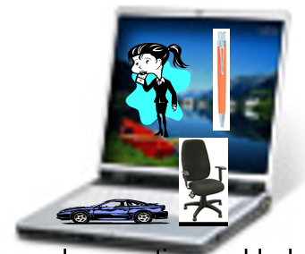
WHAT IS object?
An "object" is anything to which a concept applies, in our awareness
Things drawn from the problem domain or solution space.
E.g., a living person in the problem domain, a software component in the solution space.

Slide 13
Thinking About Objects
Objects
Reusable software components that model real-world items
Look all around you
People, animals, plants, cars, etc.
Attributes
Size, shape, color, weight, etc.
Behaviors
Babies cry, crawl, sleep, etc.

Slide 14
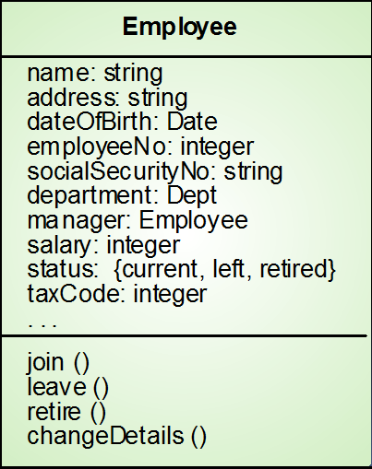
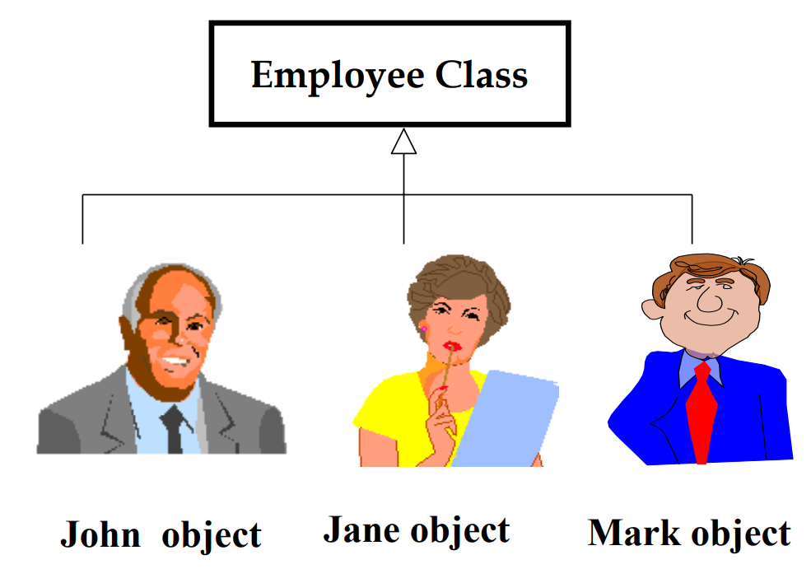
WHAT IS CLASS?
Object classes are templates for objects. They may be used to create objects
Object classes may inherit attributes and services from other object classes

Slide 15
Object-Oriented Style
Programming with Abstract Data Types
ADTs specify/describe behaviors.
Has an Basic Program Unit: Class
Implementation of an ADT.
Abstraction enforced by encapsulation.
Basic Run-time Unit: Object
Instance of a class.
associated state.

Slide 16
Object-Oriented Concepts
Data Abstraction (specifies behavior)
Encapsulation (controls visibility of names)
Polymorphism (accommodates various implementations)
Inheritance (facilitates code reuse)
Modularity (relates to unit of compilation)

Slide 17
More about ood
Object-oriented design (OOD)
Models real-world objects
Models communication among objects
Encapsulates data (attributes) and functions (behaviors)
Information hiding
Communication through well-defined interfaces
Object-oriented language
Programming is called object-oriented programming (OOP)
Java

Slide 18
LAB STUDY
11.02.2020
Download Java SE
Download Java Editor – Eclipse or Intellij
Develop Hello World Aplication and run at console
Run Hello World Aplication at editor

Slide 19

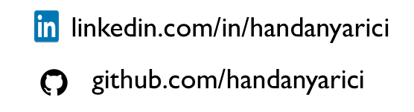
tHANKS!
handanyarici@gmail.com

